Slide 1
The fine balance Exploring the Interplay of Reproductive Strategies and Growth Dynamics in Trees
Xiaomao Wang

Slide 2

Table of content
Personal background
Research chapters
Milestones timeline

Slide 3




My personal background
Beijing Normal University-Hong Kong Baptist University United International College
Zhuhai, China
University of Michigan
Ann Arbor, US
Xishuangbanna Tropical Botanical Garden
Xishuangbanna, China
Harbin, China
Notes:
I was born and raised in Harbin, a city in northeastern China, where I often gazed at the rolling mountains outside my window, wondering: What’s on the other side? This curiosity led me to move to the southeastern part of China for college, where I first encountered ecology. For my final-year project, I studied the community ecology of a threatened seagrass species. Toward the end of our work, a restoration project was proposed to cover the seashore with fine sand. My team worked hard to negotiate with various stakeholders, ultimately stopping the project. And now the seagrass bed is protected. This was the first time I realized that studying ecology isn’t just about learning—it’s about making tangible change, even if it’s just a small one. My growing interest in ecology brought me to the University of Michigan for graduate school, where I worked with Prof. Ines Ibanez. I studied how environmental factors affect two maple species (Acer rubrum and Acer saccharum) at different latitudes. Our results showed that the southern populations were more vulnerable to rising temperatures, and climate projections suggested they could face significant declines in the future. This research helped document how populations respond differently to environmental stress, which help make predictions at a finer resolution. This work was published in Forests.
After graduation, I took a break from school and worked as a research assistant in Prof. Kyle Tomlinson’s lab, studying the ecology of savanna ecosystems. I became interested in how soil nutrients influence plant defense strategies. We developed a model showing that architectural plants, which have high nutrient content and low phenolic compounds, rely on structural defenses to deter herbivores. However, as soil nutrients increase, non-architectural plants with low nutritional value become more palatable to herbivores. This study highlighted how changes in soil phosphorus, especially in nutrient-limited environments like the tropics, can shape plant defense strategies. This study was published in Physiologia Plantarum
After three years in academia, I felt it was time for the next step, and here I am today.

Slide 4
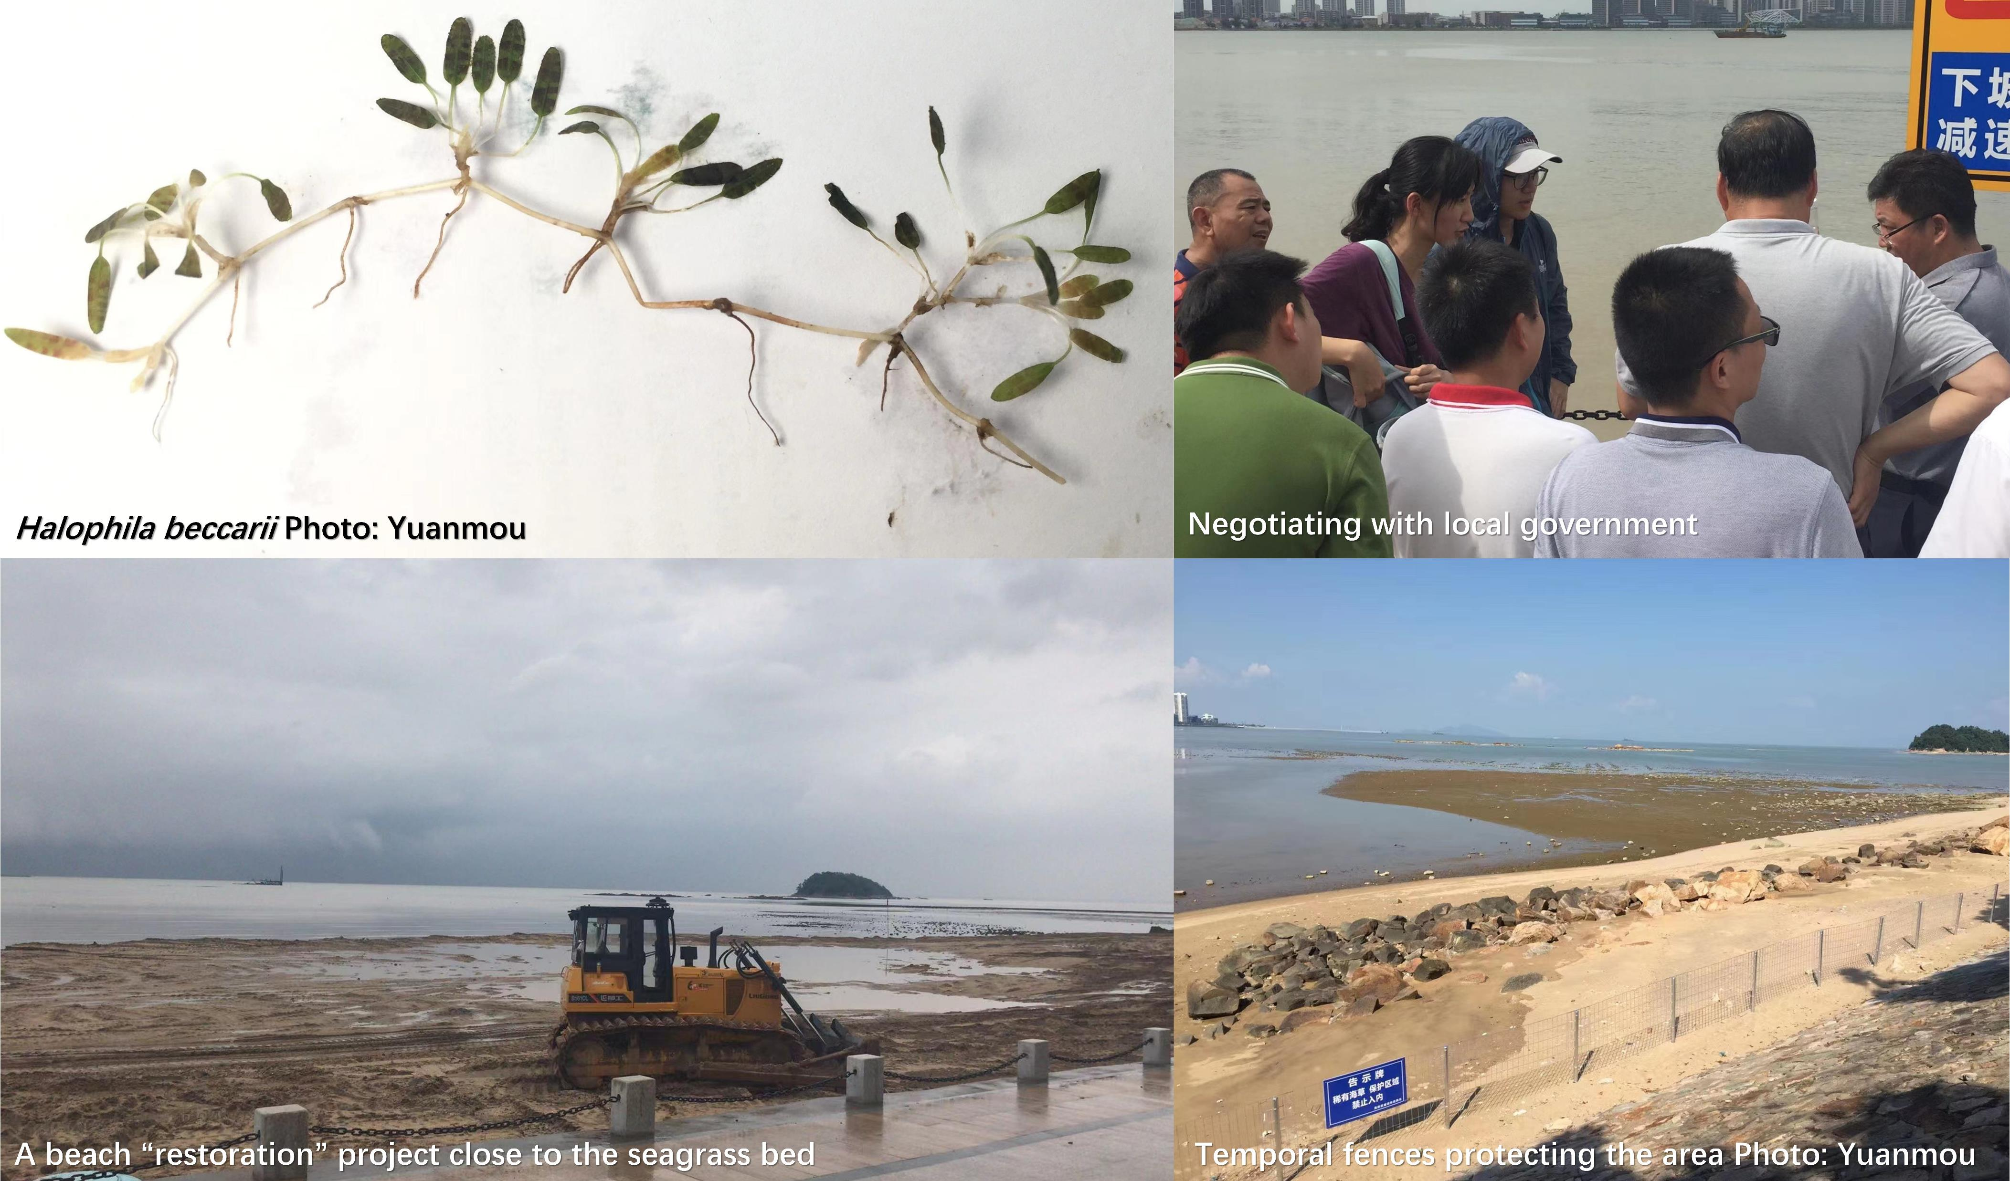
Seagrass conservation
Notes:
The exact reasons why plant mast is still not fully understood, but there are some hypothesis.
First is predator satiation hypothesis. Picture the masting year as a big buffet. When there are so much food, even the hungriest predators can’t possibly finish it all. Some seeds get eaten, but most of them survive because there are just too many to consume. And in the following years, when the seed predator bring the whole family and ready for another big buffet, there isn’t one. By masting, plants manipulate the population of seed predators and also ensure the success of their reproduction.
The next intuitive hypothesis is resource matching. A fixed fraction of resources is allocated to reproduction each year. Plants can simply be matching their reproductive output each year to the variable resources available to them.
Pollination coupling hypothesis predicts that weather and plant resources drive the flowering effort of trees, highly synchronized flowering time enable more pollination and more production of seeds.
Environmental cues believes that certain environmental shift will trigger the masting events.

Slide 5
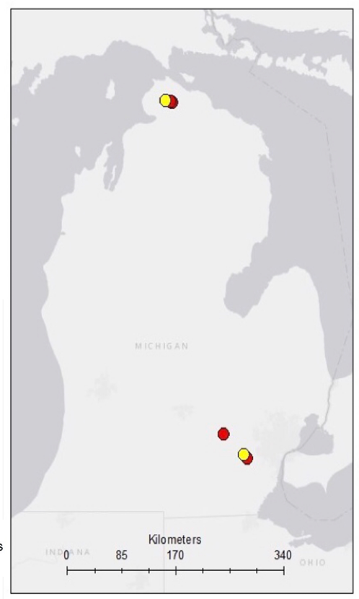
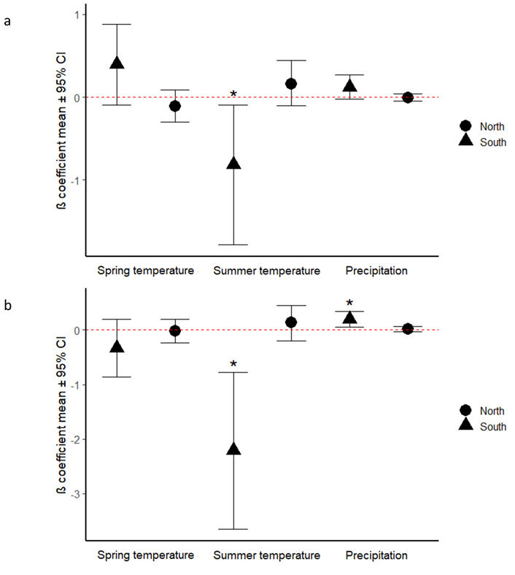
Wang et al. (2022). Forests
Dendrochronology + Bayesian analysis
Southern populations were more vulnerable to rising temperatures
populations respond differently to environmental stress
Models at finer resolution

Slide 6
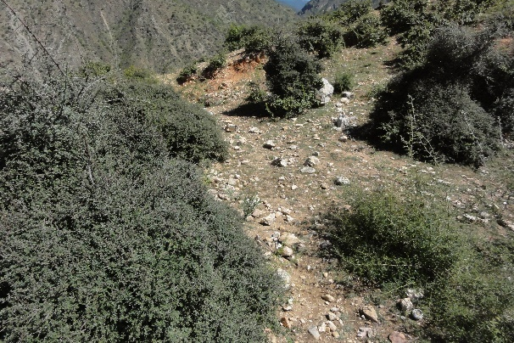
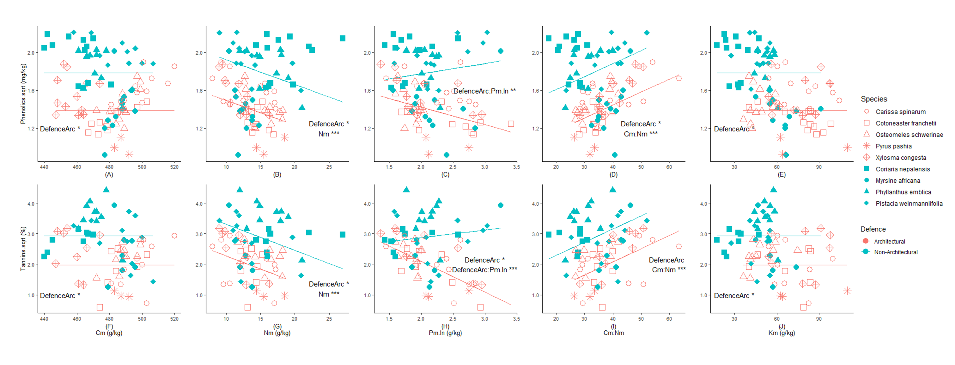
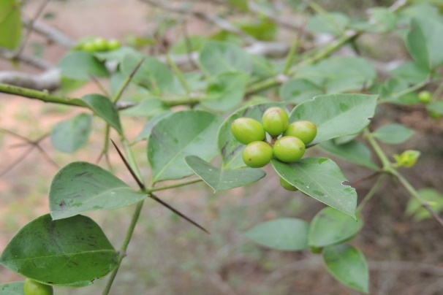

Slide 7
Mast seeding
Synchronized variation of large seed crop within a population between years
Characteristics:
Interannual variation
Synchrony
Temporal autocorrelation
frequency
Notes:
When I first talked with Lizzie about my potential PhD project. She asked me: “Do you know what is masting”. At that time, I had no clue what this term means, but after she explained it. I recall that my favorite snack during my childhood—pine nuts. We could only saw those giant Korean pine cones in farmers market every several years. People go to local forests to forage them.
Masting is the phenomenon when plants have synchronized variation of large crop seeds within a population between years. It is closely related to ecosystem-level functions since seeds can be food resources for many mammals or host for some pathogens. It is mostly common wind-pollinated species, but also occurs in Poaceae as well as Diperocarpaceae. Some literatures also said that some fruit trees also mast.
Mast seeding is characterized by four main features: interannual variation, seed crop is different in magnitude across years; synchrony: it involves the synchronized production of seeds across individuals and populations, sometime it can even extend across hundreds of kilometers; temporal autocorrelation: tendency for high seed production years will followed by low seed production years; frequency: masting occurs every few years and normally this frequency won’t change a lot.

Slide 8
Hypotheses on masting
Notes:
The exact reasons why plant mast is still not fully understood, but there are some hypothesis.
First is predator satiation hypothesis. Picture the masting year as a big buffet. When there are so much food, even the hungriest predators can’t possibly finish it all. Some seeds get eaten, but most of them survive because there are just too many to consume. And in the following years, when the seed predator bring the whole family and ready for another big buffet, there isn’t one. By masting, plants manipulate the population of seed predators and also ensure the success of their reproduction.
The next intuitive hypothesis is resource matching. A fixed fraction of resources is allocated to reproduction each year. Plants can simply be matching their reproductive output each year to the variable resources available to them.
Pollination coupling hypothesis predicts that weather and plant resources drive the flowering effort of trees, highly synchronized flowering time enable more pollination and more production of seeds.
Environmental cues believes that certain environmental shift will trigger the masting events.

Slide 9
Research questions
1. What are some reproductive traits related to mast seeding
2. What is the relationship between masting and growth
3. How future climate change is going to affect masting
Notes:
All these hypothesis will somehow explain the reason of masting, but the main result controlling the masting event might vary by species and abiotic environment. For my PhD project, I would like to explore more about the masting,
Questions I am going to ask are:
1. What are some reproductive traits related to mast seeding
2. What is the relationship between masting and growth
3. How future climate change is going to affect masting

Slide 10
Notes:
My first chapter is going to be a meta-analysis trying to figure out what reproductive traits are highly related to whether a species mast or not. Understanding the reproductive traits that underlie mast seeding is important for understanding the mechanisms that drive this behavior and the strategies plants use to maximize their reproductive success.
We consider the reproductive traits we would like to select based on different reproductive stages: pollination, seed maturation and seed dispersal. As well as different hypotheses.
Seed size, seed nutrient content, dispersal mode, seed dormancy, seed longevity.
Type of reproduction, flowering duration, pollinators
Leaf longevity and determinacy

Slide 11
Growth-Reproduction Trade-off
Growth
Defence
Resources
Reproduction
Storage
Notes:
Plants have limited resources and must actively allocate them to support survival and reproduction. How they allocate their resources is influenced by environmental factors and the plant’s life history strategy. Trade-offs are important for plant fitness because plants cannot maximize all aspects of their life processes with limited resources. Masting as a special reproductive event involving the production of lots of seeds in certain yet, it is intuitive to expect a growth-reproduction trade-off, with the growth of plants during masting years might be impacted. This relationship might be even more complex for conifer species, whose reproductive cycles typically last for two years. In this chapter, I will combine growth data, seed trap data and climate data to explore the relationship between masting and plant growth.

Slide 12

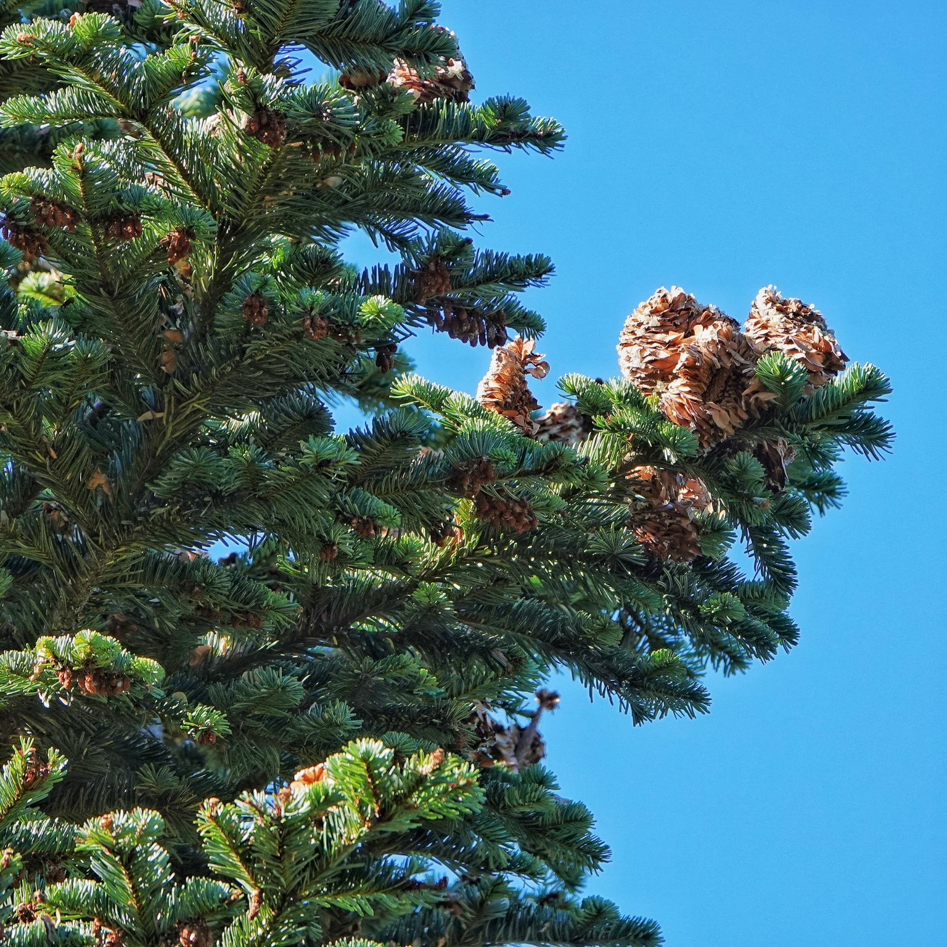
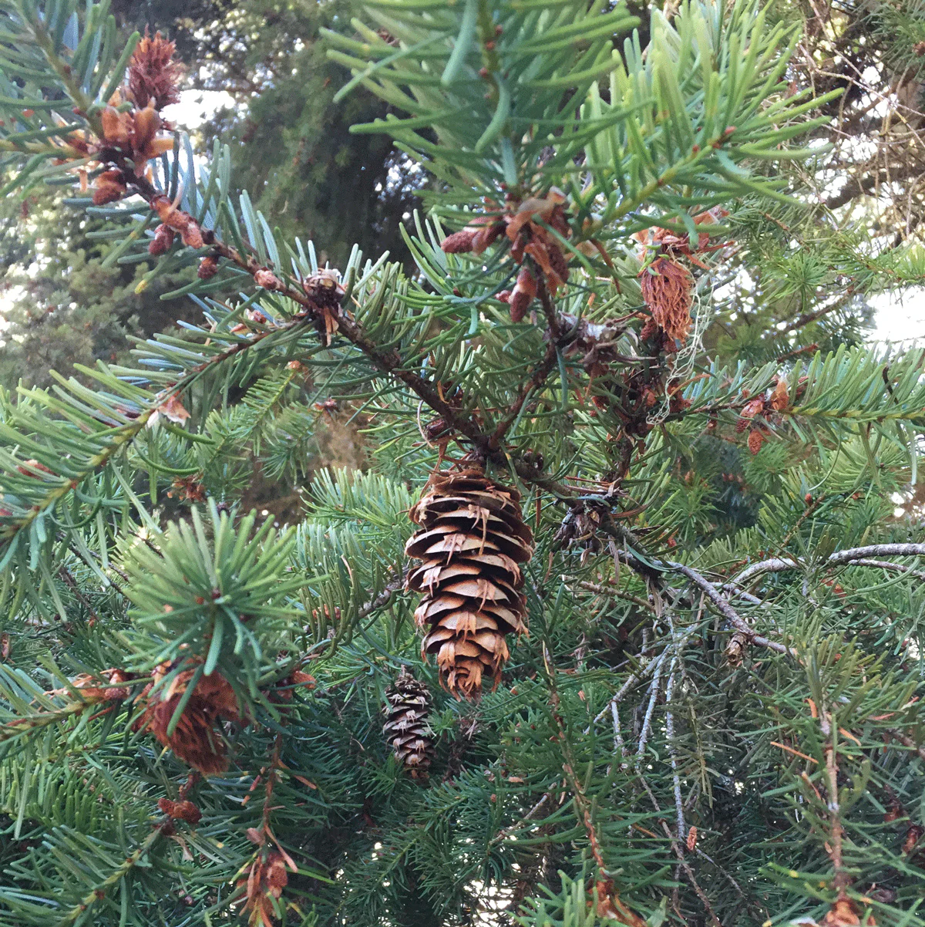
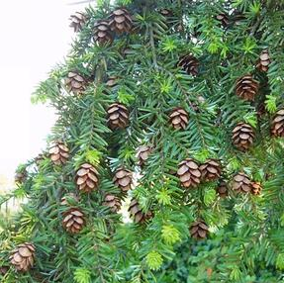
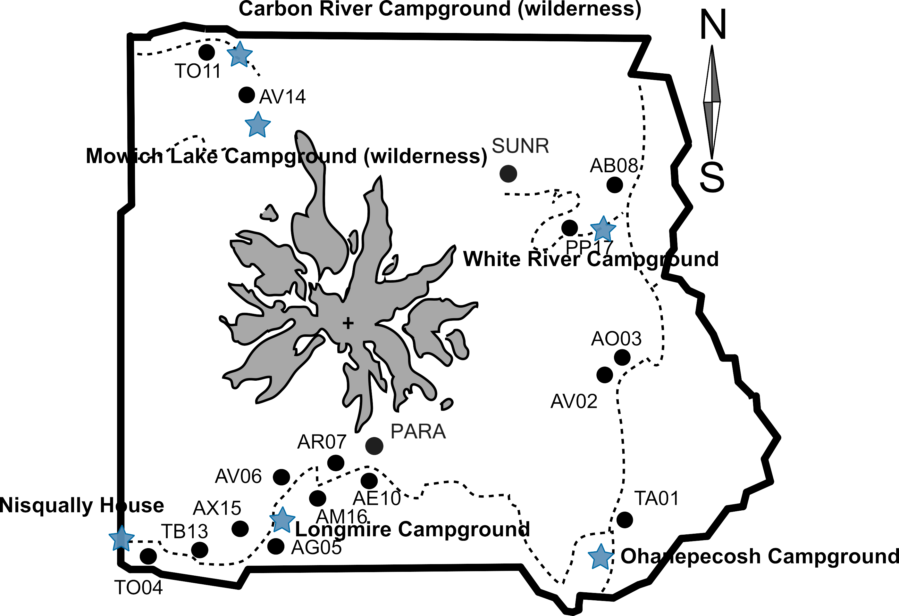
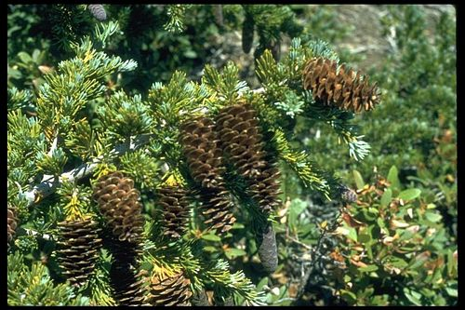
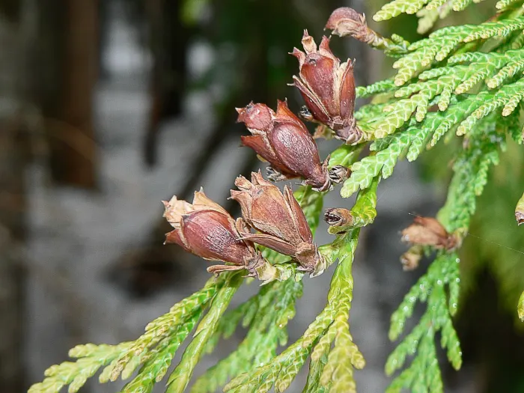
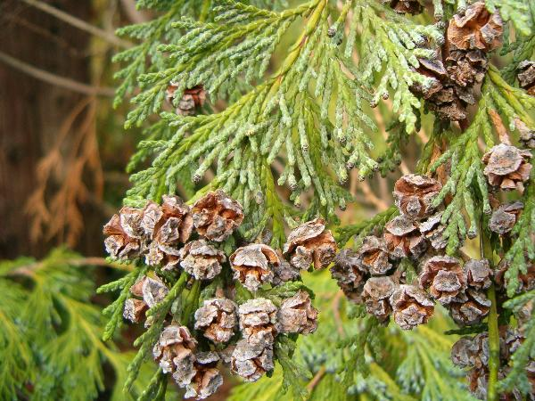
Notes:
We chose Mount Rainier for this study, and this simplified map shows the stands we selected, labeled across an elevational gradient on two sides of the mountain. Our collaborator, Janneke, has been collecting seed data in these stands for years. Individuals growing at higher elevations face more stressful environmental conditions, and we expect that their resource allocation strategies during masting years may differ from those at lower elevations. Furthermore, species may respond differently depending on their growth strategies—those with more conservative strategies might allocate resources differently from species with more acquisitive growth strategies. All these aspects at the same time will cause different populations respond differently towards climatic variations.
Species we selected for this study are listed in the table, they are common species and can be found in at least four stands. Pacific Silver Fir, Western Hemlock, Mountain Hemlock, Western Red Cedar and Yellow cedar are relatively conservative species. Douglas fir are relatively more acquisitive.

Slide 13

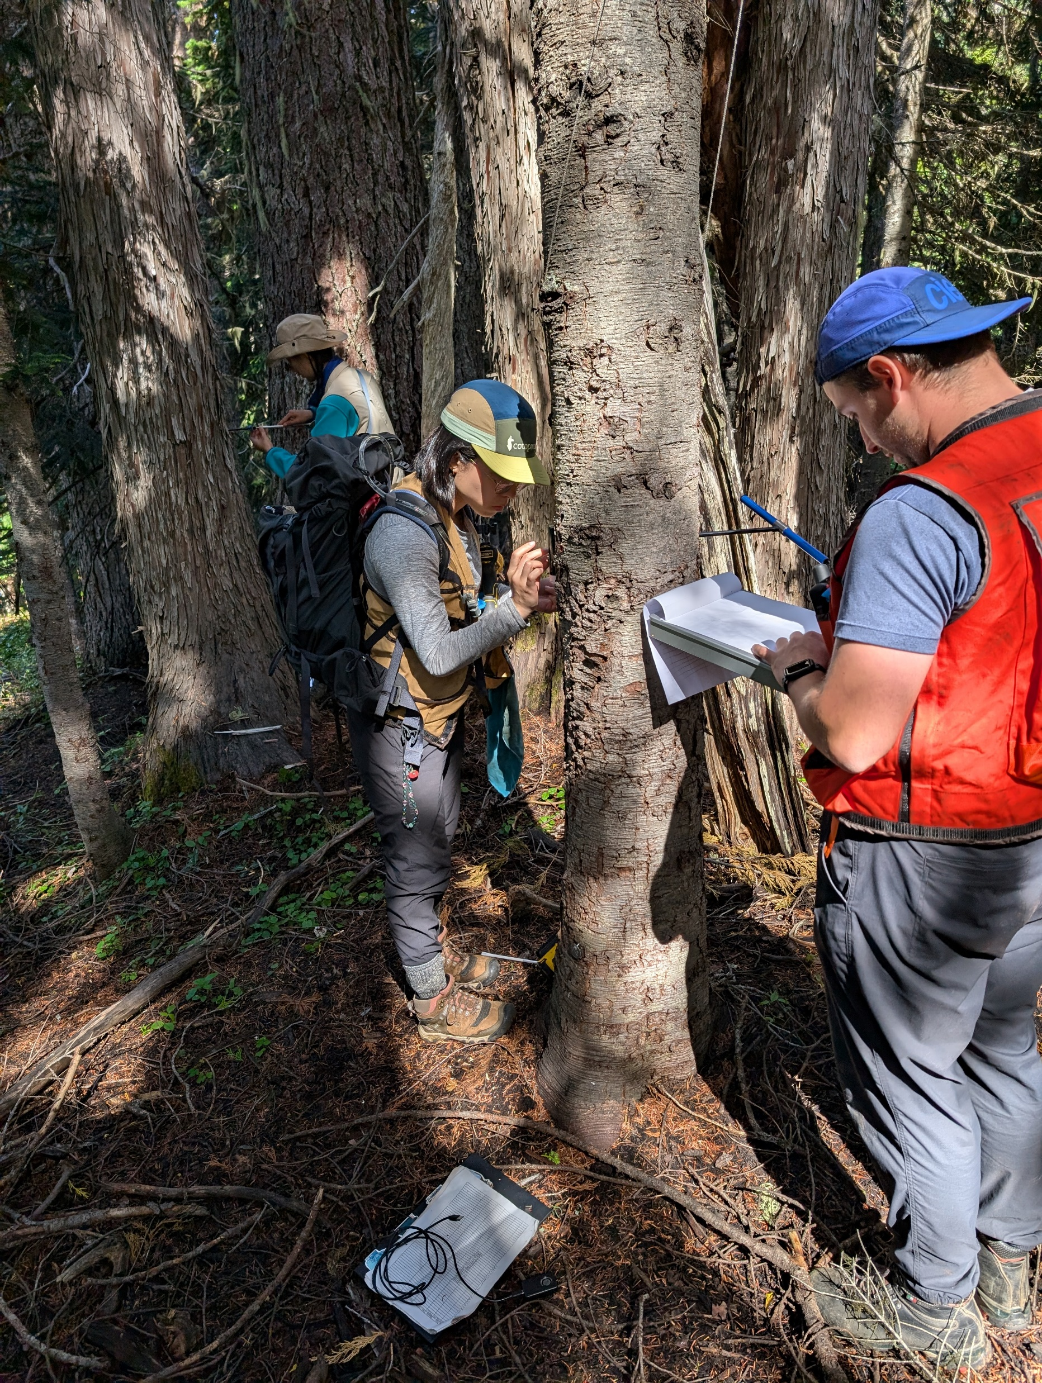
Notes:
We planned to collect tree cores from 25 individuals per species per stand, covering a size gradient. To make sure that the trees we cored were mature enough to have reproduced at least 10 years ago, I selected only trees with a DBH greater than 25 cm. Additionally, I prioritized individuals located close to seed traps to better correlate with seed data. We expect to see a decrease in growth during the masting year, or even in the year before. However, we may also observe a period of increased growth leading up to the mast year. This relationship could vary between species and across different elevation gradients. Individuals at higher elevations may exhibit a more pronounced trade-off between growth and reproduction.

Slide 14
Notes:
Proposed another chapter on how climate change is likely going to affect masting events in the future.

Slide 15

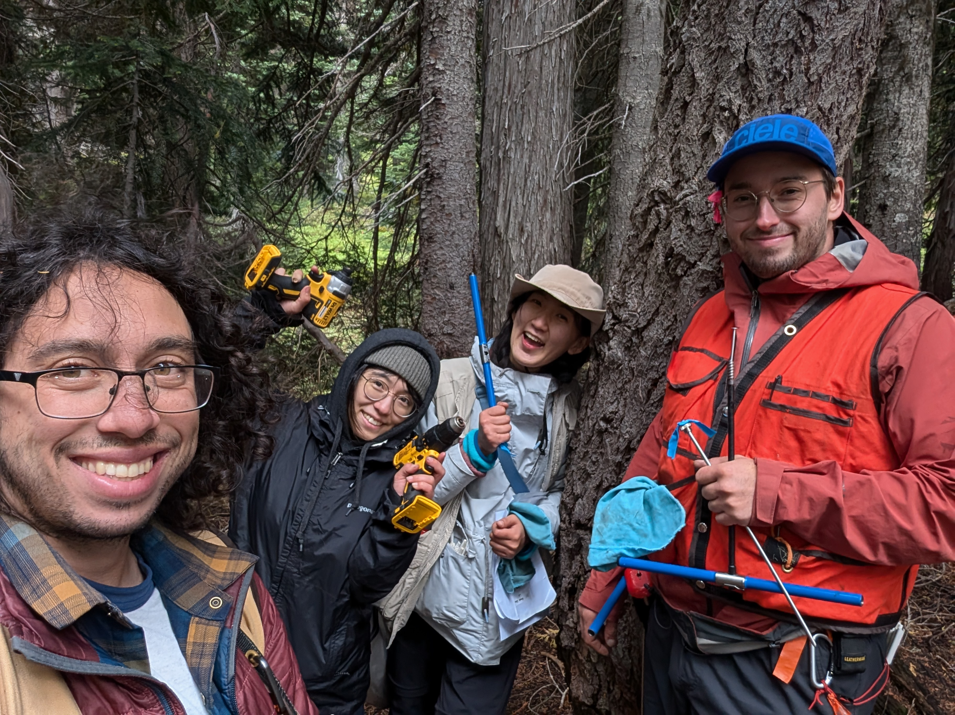
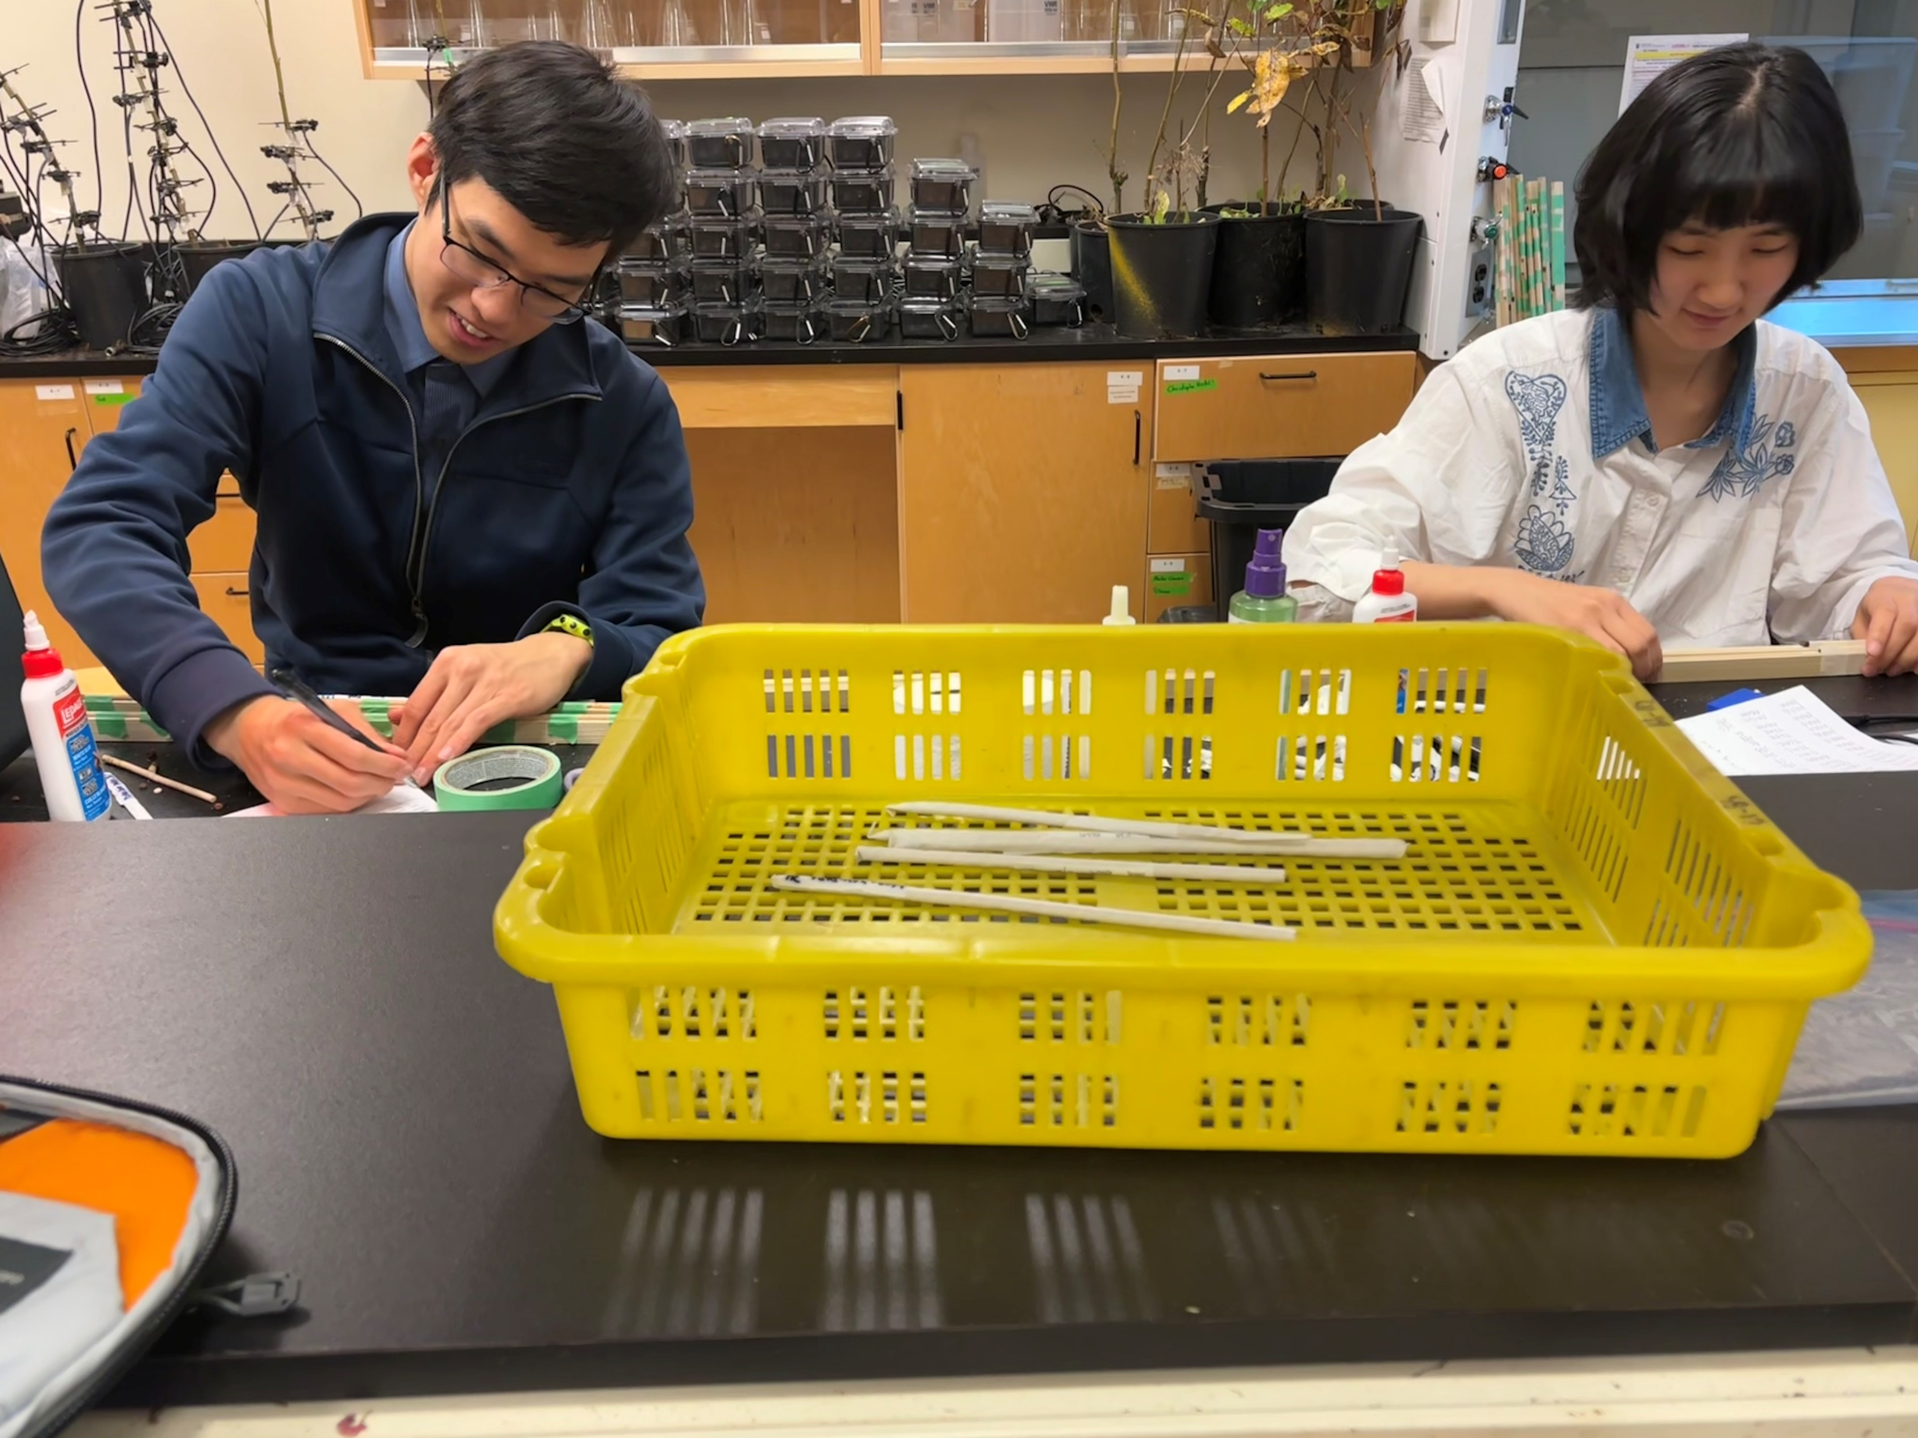
Current progress
Data scraping from Silvics almost done
Collected tree cores from more than 600 individuals
Mounting cores
Notes:
During the past field season, I collected tree cores from more than 600 individuals in 10 stand at different elevations with the help of my awesome field crew.
We are currently mounting these tree cores, hopefully we will finish core mounting by the end of this year, and then we can start looking at our cores.
In the next year, I will concentrate on getting more data for my meta-analysis chapter and start analysis. I will finish scanning and checking all cores before next field season and see if collecting more cores are needed. If so, I will go to collect more cores in summer.

Slide 16
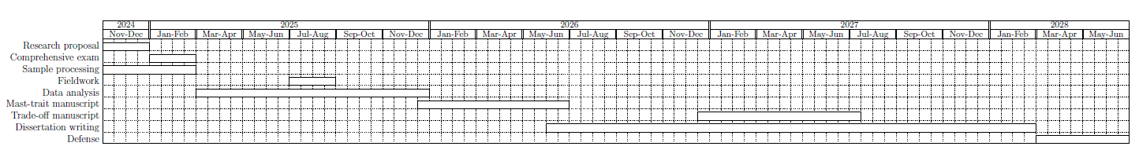
Timelines for milestones for PhD
Notes:
This is a drafted timeline for milestones for my PhD. The most recent two events are the submission of my proposal and comprehensive exam. We can discuss about this later and schedule a time together.

Slide 17
Key references

Slide 18
Notes:
Going back to where the story started, what’s on the other side of mountain. There are ocean, savanna, forests, and even just more mountains. There is a whole world to explore. And I am looking forward to challenge myself during this PhD journey.

